Slide 1

Lab 5

Slide 2
Lab Goal
Understanding the implementation of a hash set
You will be using the following data structures that you have learned already to create the hash set
Linked list (called list in c++)
Vector
Because you are expected to make your own hash set you are not allowed to use c++ data structures that use hashing
Ex: unordered_map and unordered_set

Slide 3
Code To Write
insert(string word)
This function is responsible for adding new words to the set
All values in a set are unique so this function will only add a word if it does not already exist in the set
This function must also double the size of the table when num_elems == size, where num_elems is the current number of words in the table and size is the current size of the table
find(string word)
This function will return a Boolean
Will return true if the word is in the list, otherwise it will return false

Slide 4
Code To Write (cont.)
remove(string word)
This function will remove the given word from the list
loadStringset(stringset& words, string filename)
This function will have to open a file of the given name and insert all the words in the file into the stringset
Spellcheck(stringset& words, string word)
This function will take the given word and return a vector of all the words in the stringset that are one letter away from the word
A word is considered one letter away if you can change one letter at any position within the word to create another word
Ex: read -> {dead, road, reed, real}

Slide 5
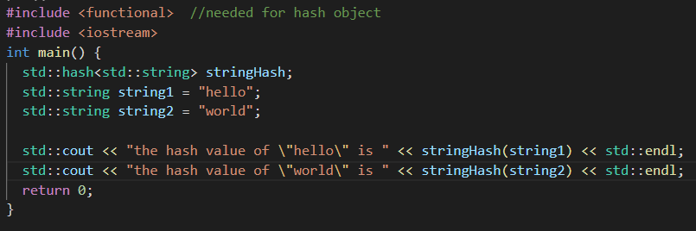
How to hash
There is a hash object that is used to hash values of a given type
Below is an example of how you would hash strings

Slide 6
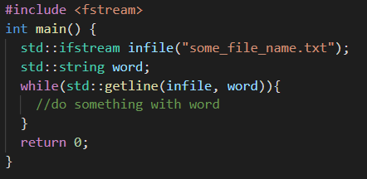
Reading Strings From a File
Below is an example of how you would read all the lines from a file
The function getline will read in an entire line from the given file and store that line into the given string
Once the entire file has been read getline will return false which will end the while loop

Slide 7



Insertion Example
Insert(“hello”)
After
Before
Table =
Size = 4
Num_elems = 0
Table =
Size = 4
Num_elems = 1
insert_location = hash(“hello”) % 4 = 0

Slide 8
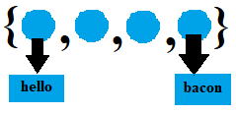
Insertion Example (cont.)
Insert(“bacon”)
After
Before
Table =
Size = 4
Num_elems = 1
Table =
Size = 4
Num_elems = 2
insert_location = hash(“bacon”) % 4 = 3

Slide 9
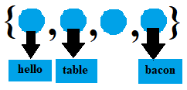
Insertion Example (cont.)
Insert(“table”)
After
Before
Table =
Size = 4
Num_elems = 2
Table =
Size = 4
Num_elems = 3
insert_location = hash(“table”) % 4 = 1

Slide 10
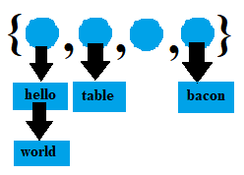
Insertion Example (cont.)
Insert(“world”)
After
Before
Table =
Size = 4
Num_elems = 3
Table =
Size = 4
Num_elems = 4
insert_location = hash(“world”) % 4 = 0

Slide 11
Insertion Example (cont.)
Insert(“table”)
After
Before
Table =
Size = 4
Num_elems = 4
Table =
Size = 4
Num_elems = 4
the word “table” already exists so no changes made

Slide 12
Insertion Example (cont.)
Insert(“banana”)
Before
Table =
Size = 4
Num_elems = 4
size == num_elems so we must double the size of the table, rehash the existing values and then add the new word

Slide 13
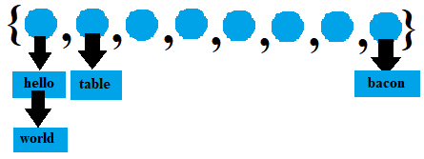
Insertion Example (cont.)
Insert(“banana”)
New Hash Values
“hello” = hash(“hello”) % 8 = 0
“world” = hash(“world”) % 8 = 0
“table” = hash(“table”) % 8 = 1
“bacon” = hash(“bacon”) % 8 = 7
Table =

Slide 14
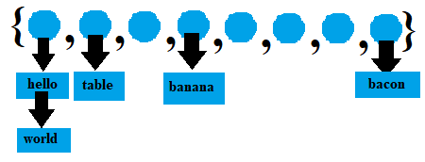
Insertion Example (cont.)
Insert(“banana”)
Before
Table =
Size = 4
Num_elems = 4
After
Table =
Size = 8
Num_elems = 5
insert_location = hash(“banana”) % 8 = 3

Slide 15
Some Hints
When finding and removing from the table use the same hashing technique used for insertion to get the proper location within the vector, and then loop through the linked list at that spot until you find your value
The size of the table only gets bigger. You do not need to worry about resizing the size of the table when removing items. However, you will need to make sure you decrease the value of num_elms.
When you submit your files make sure you submit all the word list text files or some of the test cases will fail

